Slide 1

LLM Agent Overview Part 3
Jiaxuan You
Assistant Professor at UIUC CDS
CS598: Topics in LLM Agents, 2025 Spring
https://github.com/ulab-uiuc/CS598-Topics-in-LLM-Agents

Slide 2
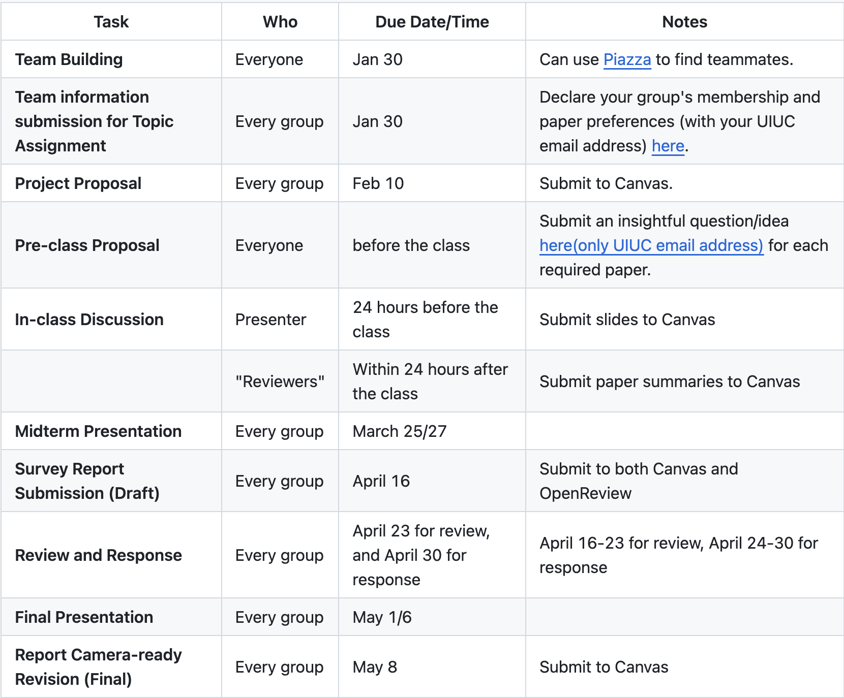
Reminders
Start finding teammates now!
(Or we will assign teammates for you)
Declare your group membership and preference by Today
https://github.com/ulab-uiuc/CS598-Topics-in-LLM-Agents

Slide 3
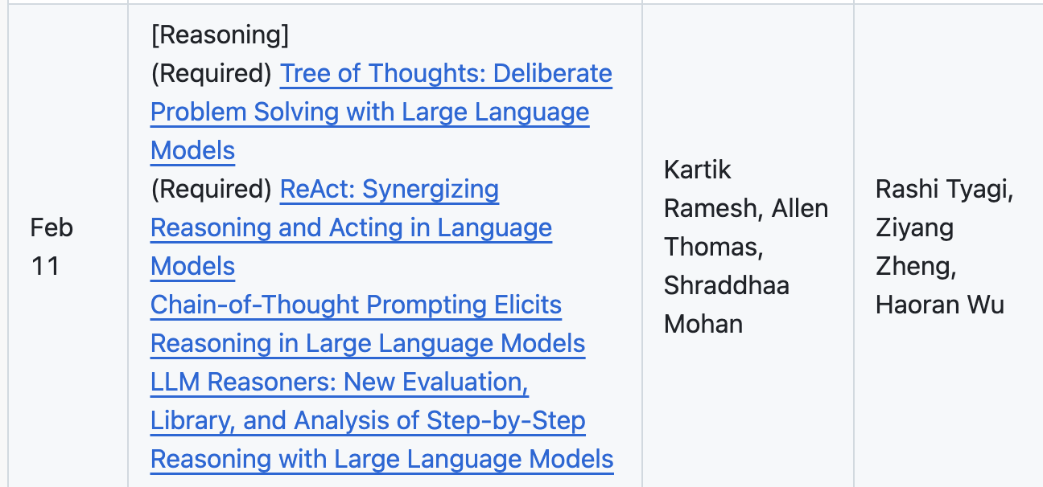
Announcements
Presenter and Reviewer group for Feb 11 is out (https://github.com/ulab-uiuc/CS598-Topics-in-LLM-Agents)
The schedule updated and one group could have 4 members
Please email TA if you want this quota (First come first served).

Slide 4
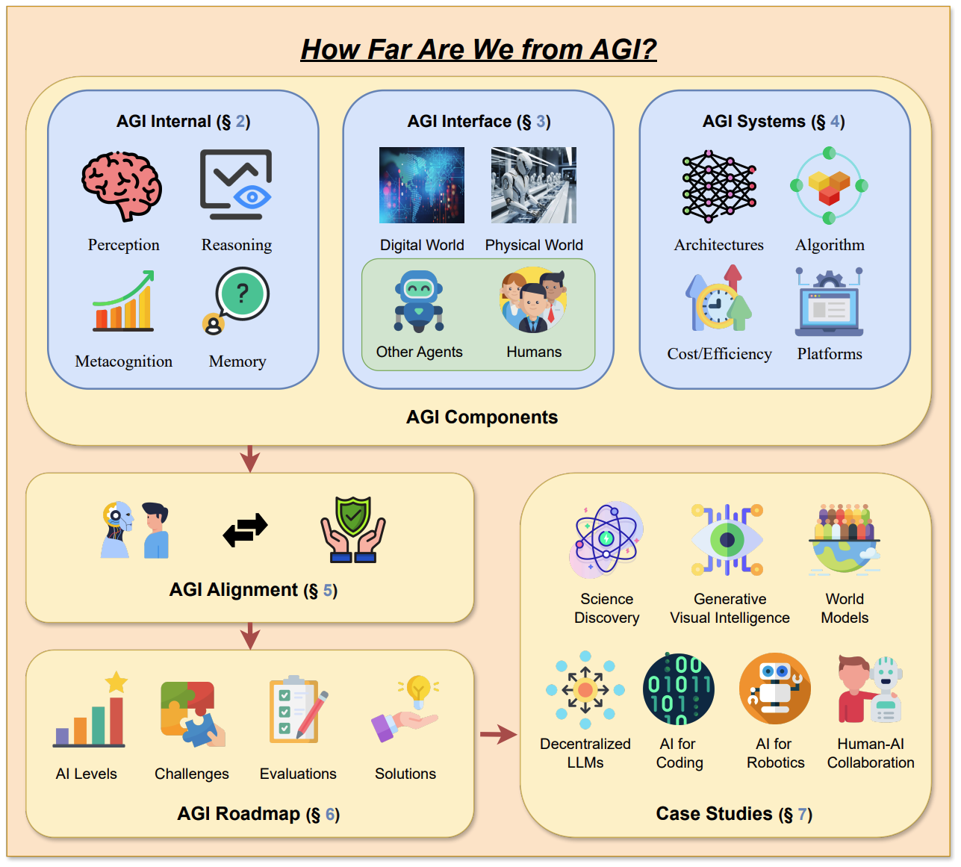
Recap: A Framework for LLM Agent Research

Slide 5
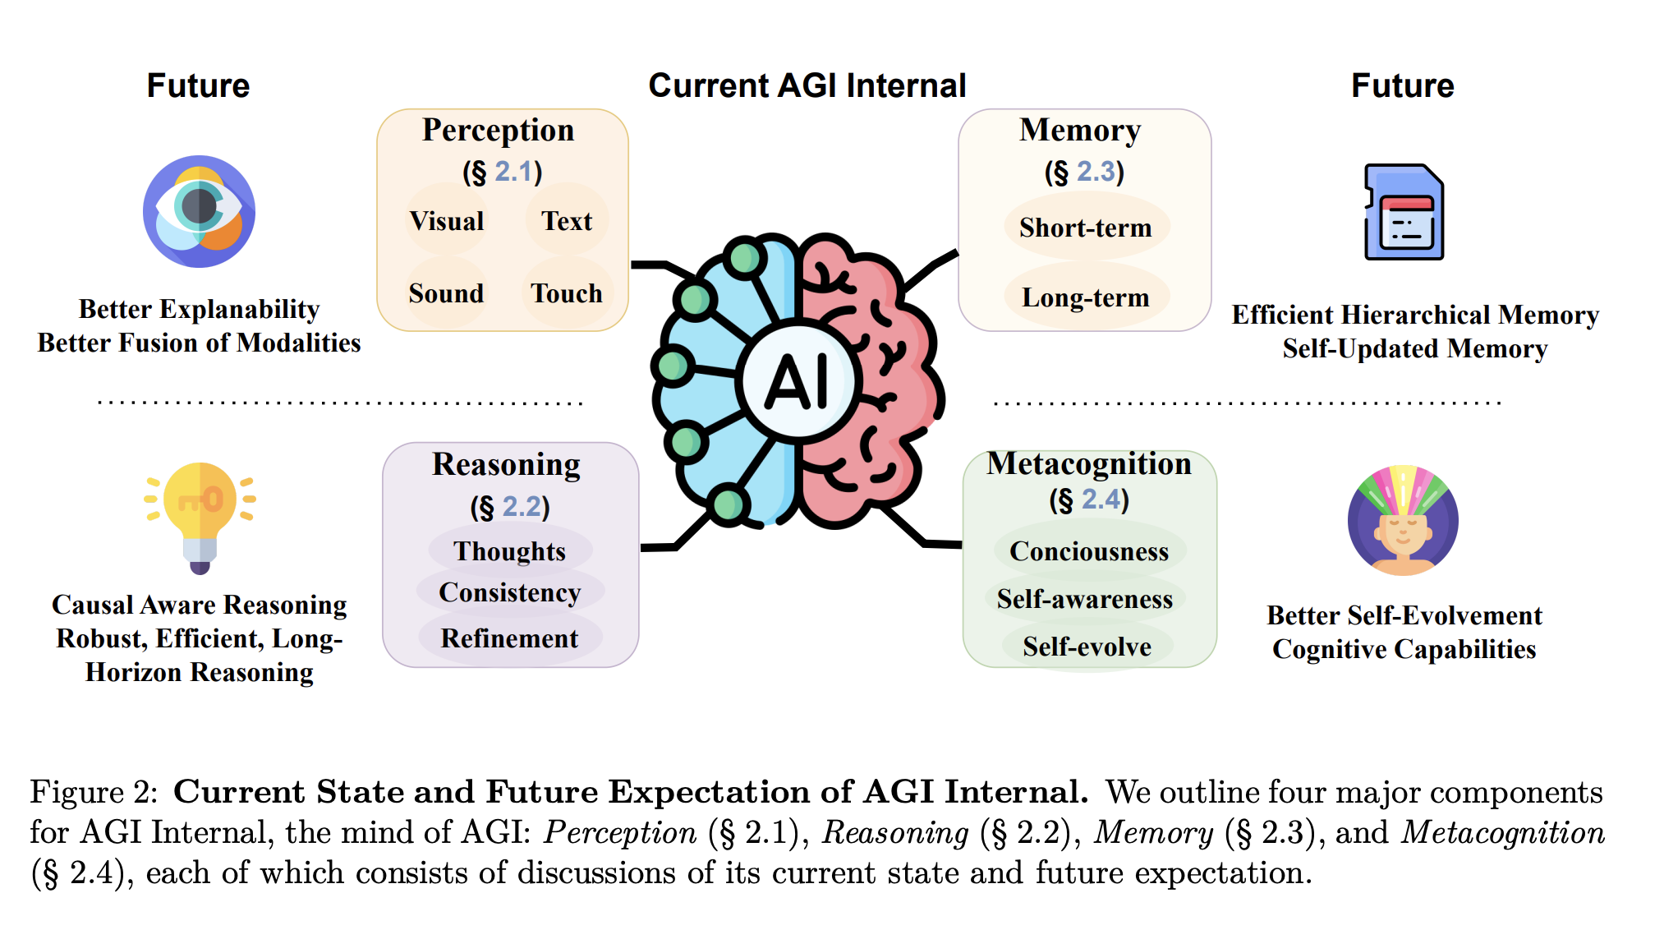
Recap: AGI Internal

Slide 6
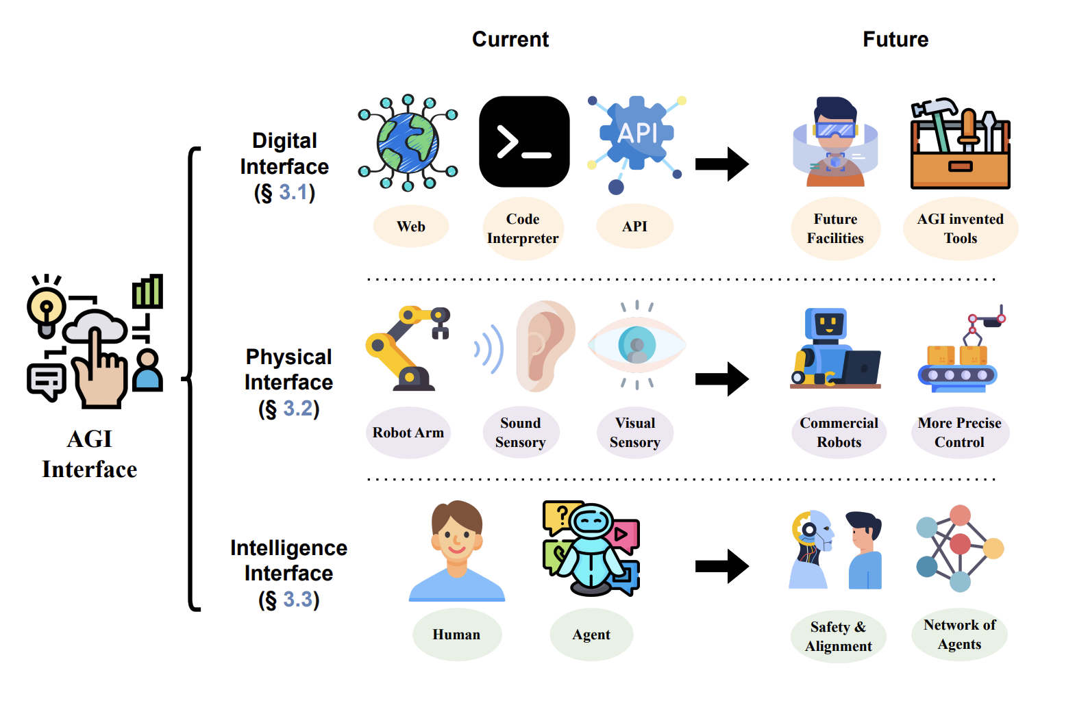
Recap: LLM Agent Interfaces
🌟Discussion: Where is the boundary between internal and boundaries?

Slide 7
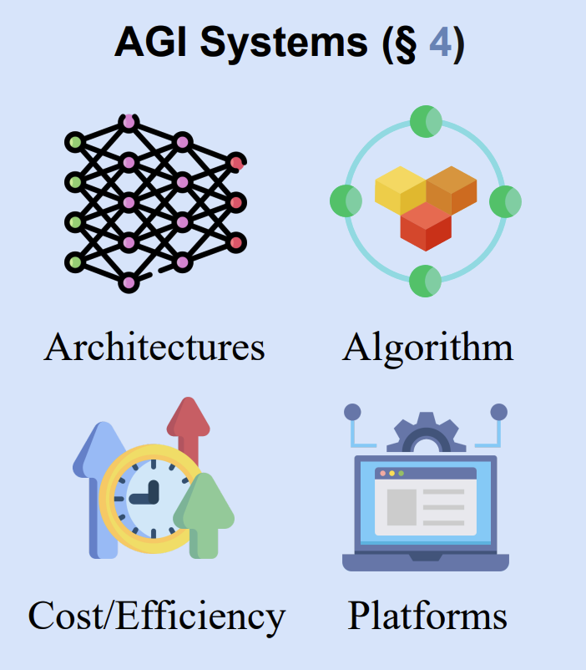
AGI Systems

Slide 8
AGI Systems
Overall challenges
Amount of training data
Cost of training
Efficient finetuning
Serving memory, latency, and throughput
Hardware compatibility
Privacy

Slide 9
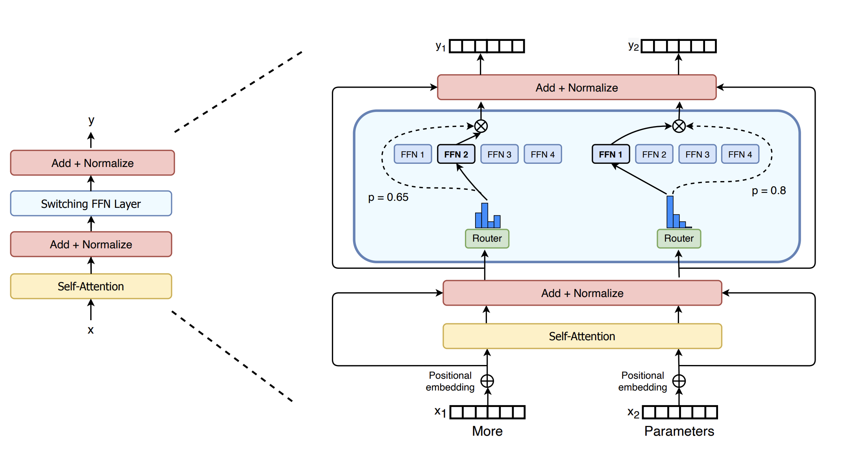
Architecture: Beyond Transformer
Mixture of Experts
Mixture of Experts
Switch Transformers: Scaling to Trillion Parameter Models with Simple and Efficient Sparsity, JMLR 2022

Slide 10
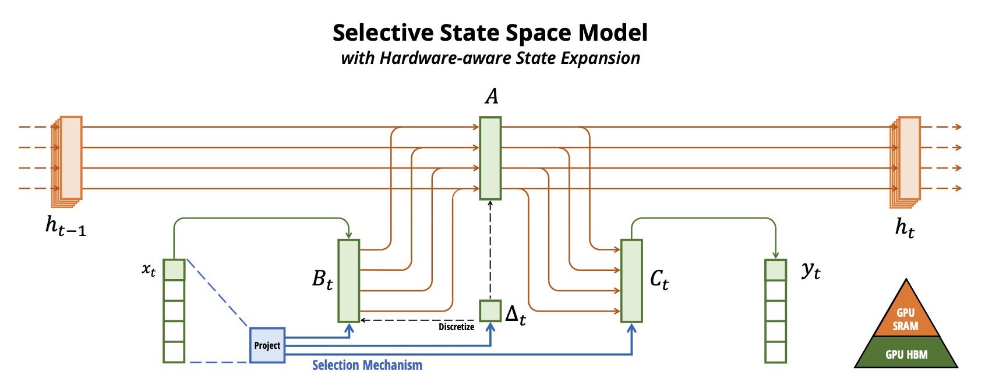
Architecture: Beyond Transformer
Mamba: Linear-Time Sequence Modeling with Selective State Spaces, COLM 2024

Slide 11
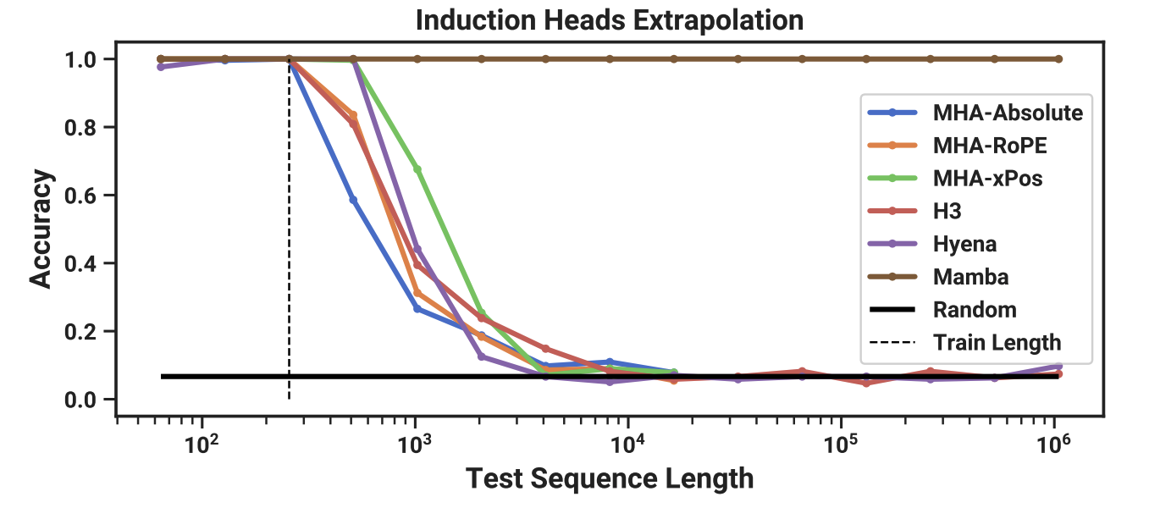
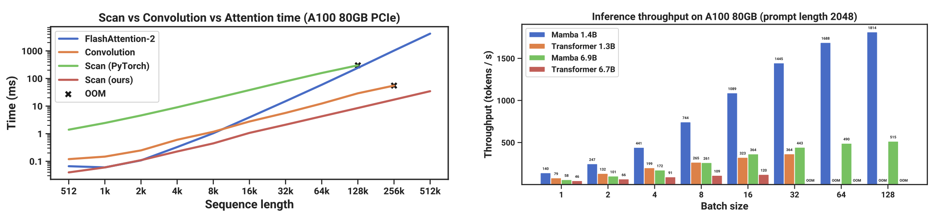
Architecture: Beyond Transformer
State space models are more efficient at inference time

Slide 12
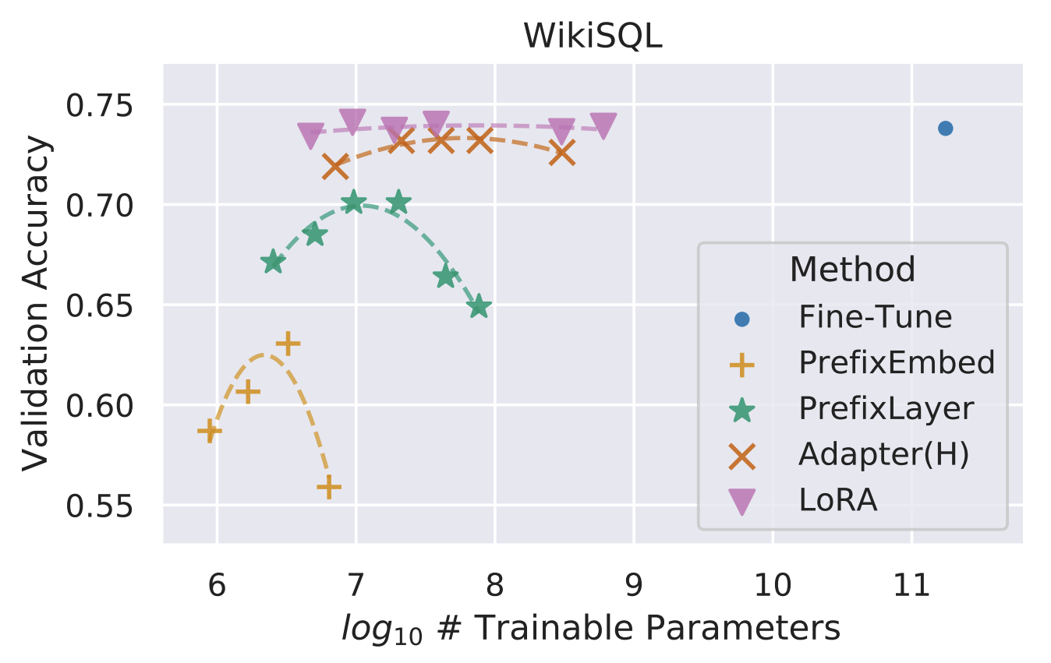
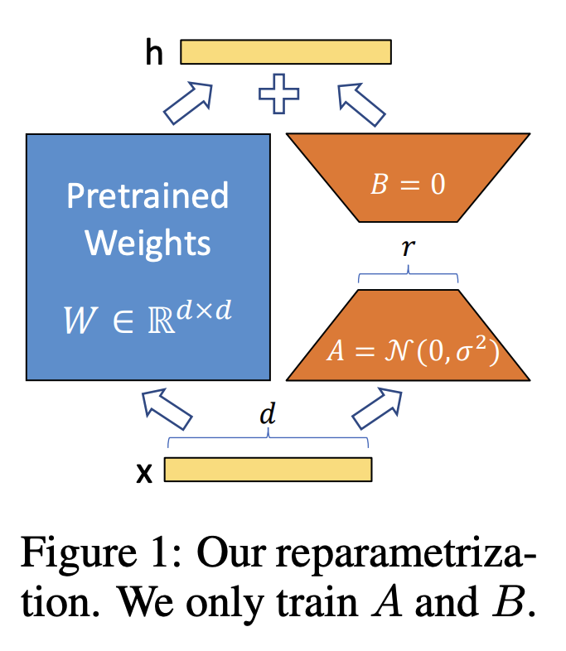
Efficient Finetuning
LoRA: Low-Rank Adaptation of Large Language Models

Slide 13
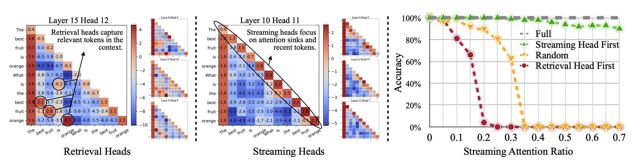
KV Cache Compression
DuoAttention: Efficient Long-Context LLM Inference with Retrieval and Streaming Heads, 2024

Slide 14
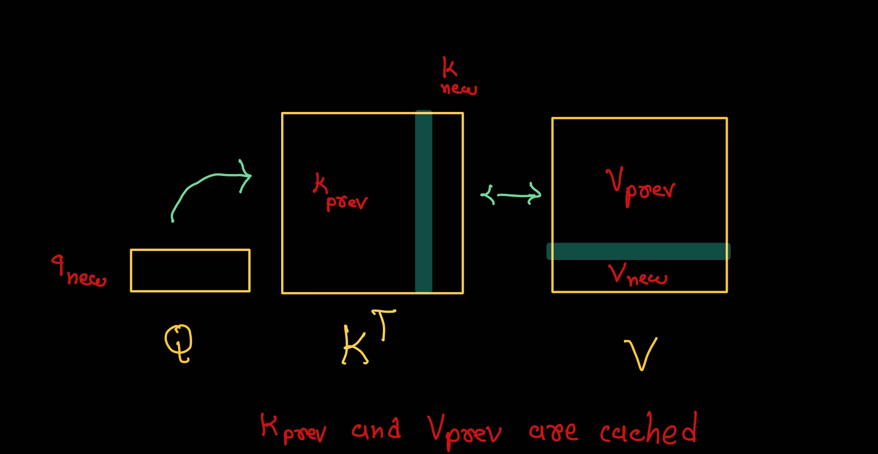
KV Cache

Slide 15
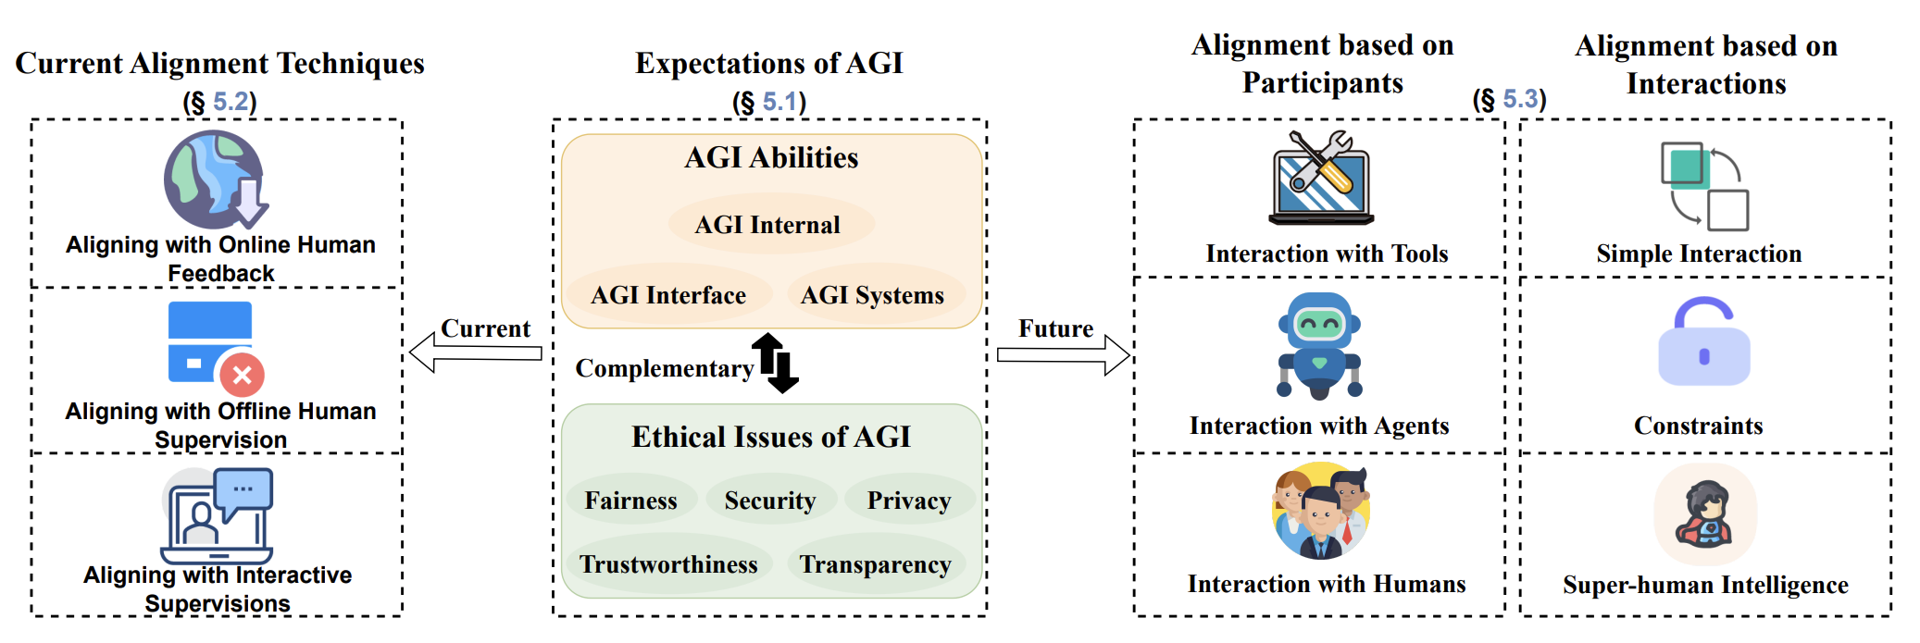
AGI Alignment
The First Law: A robot may not injure a human being or, through inaction, allow a human being to come to harm. The Second Law: A robot must obey the orders given to it by human beings except where such orders would conflict with the First Law. The Third Law: A robot must protect its own existence as long as such protection does not conflict with the First or Second Law. — Isaac Asimov, I, Robot

Slide 16
Expectations of AGI Alignment
Fairness
Avoid discriminations
Trustworthiness
No false claims
Transparency
Explainable
Security
Avoid using LLMs for attacks
Privacy
Personal info, copyright

Slide 17
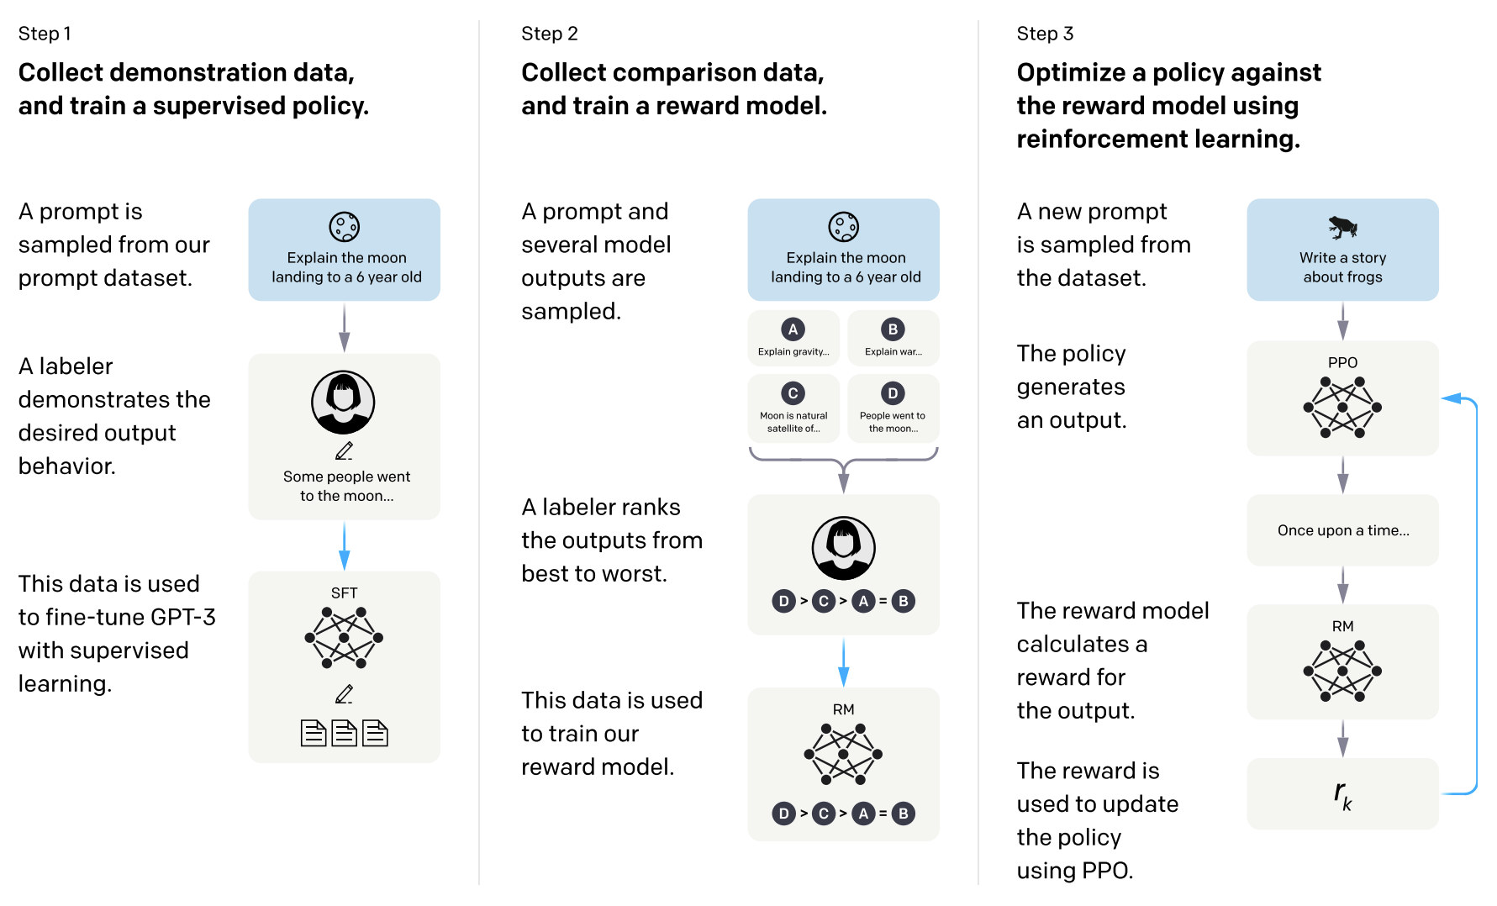
Alignment Techniques: Human Feedback
Training language models to follow instructions with human feedback, NeurIPS 2022

Slide 18
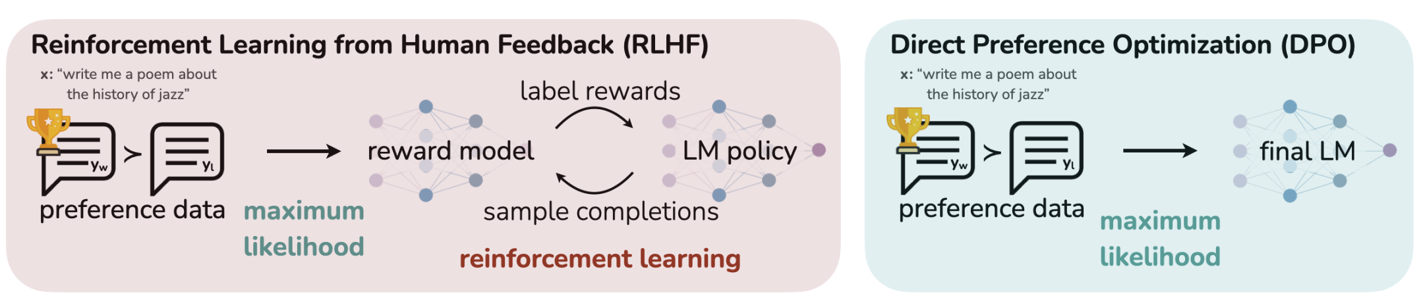
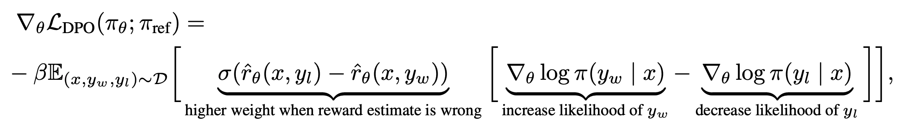
Alignment Techniques: Human Feedback
Direct Preference Optimization: Your Language Model is Secretly a Reward Model, NeurIPS 2023

Slide 19
Expectations of AGI Alignment: Discussions
Fairness
Trustworthiness
Transparency
Security
Privacy
🌟Discussions: Are these principles sufficient? Other alignment expectations?

Slide 20
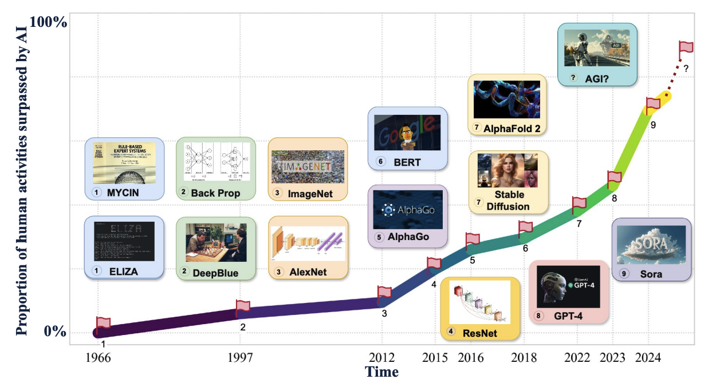
AGI Roadmap: Potential AGI Levels

Slide 21
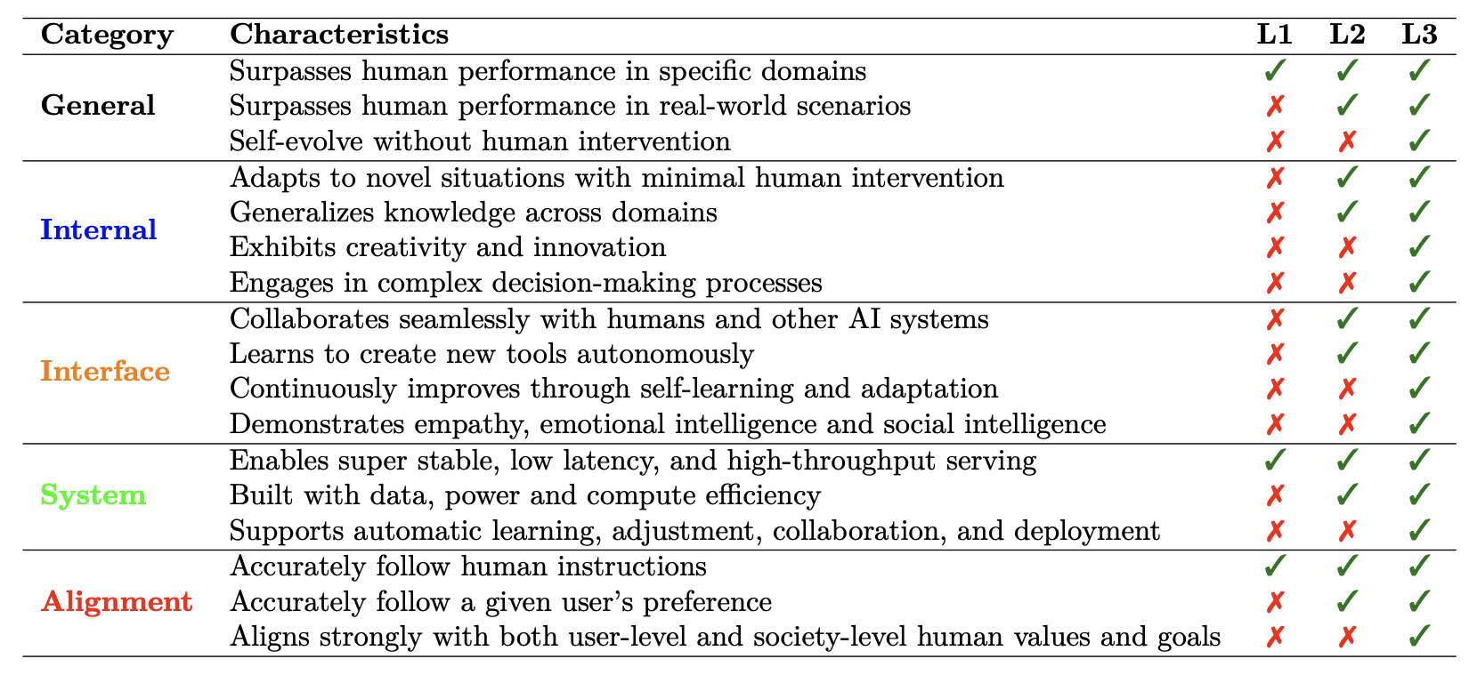
AGI Roadmap: Potential AGI Levels

Slide 22
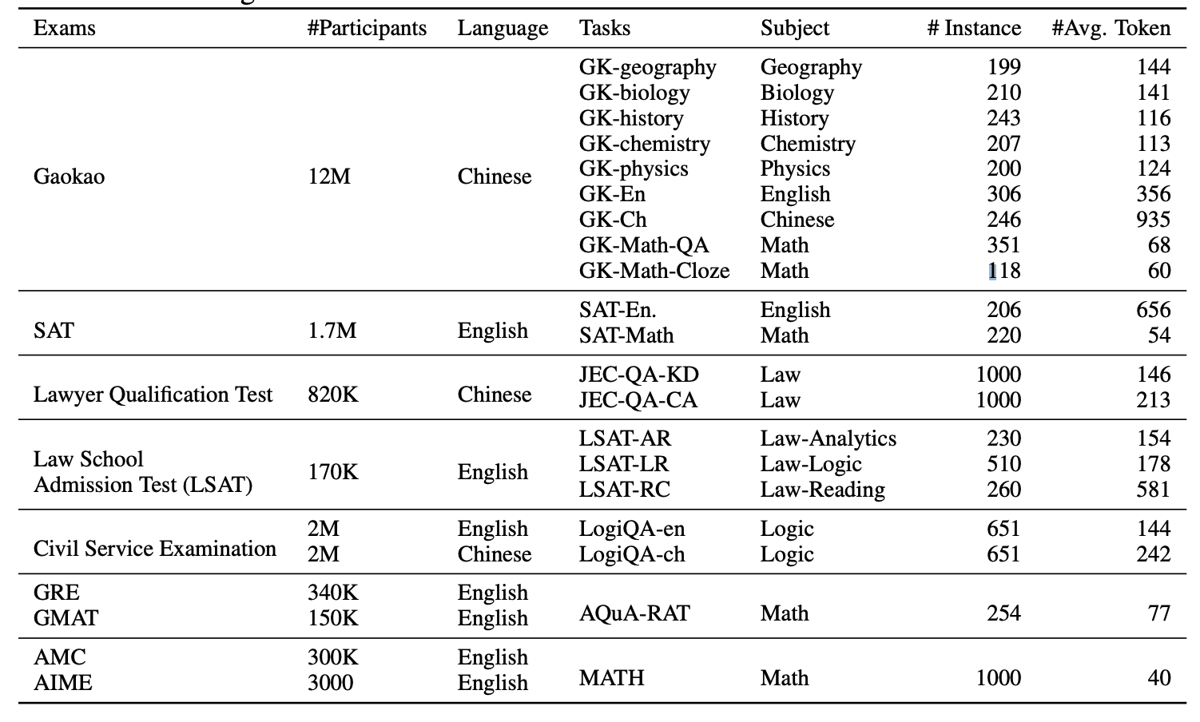
AGI Evaluation
AGIEval: A Human-Centric Benchmark for Evaluating Foundation Models

Slide 23
AGI Roadmap: Discussions
🌟Discussions: Do you believe the current foundation model research trend will lead to AGI? Why or why not?

Slide 24
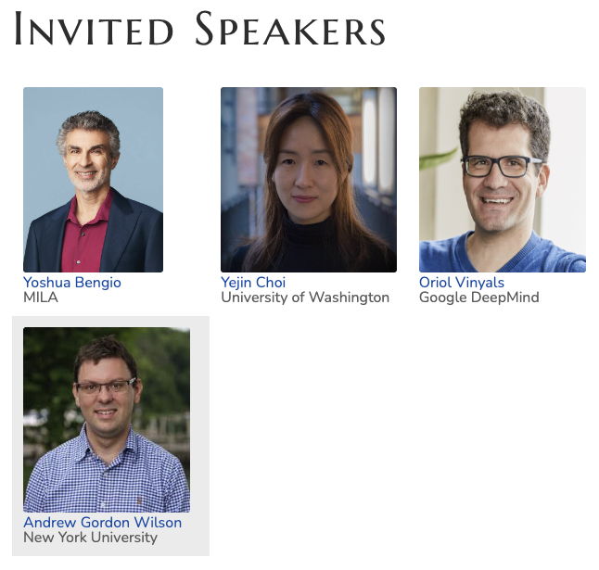
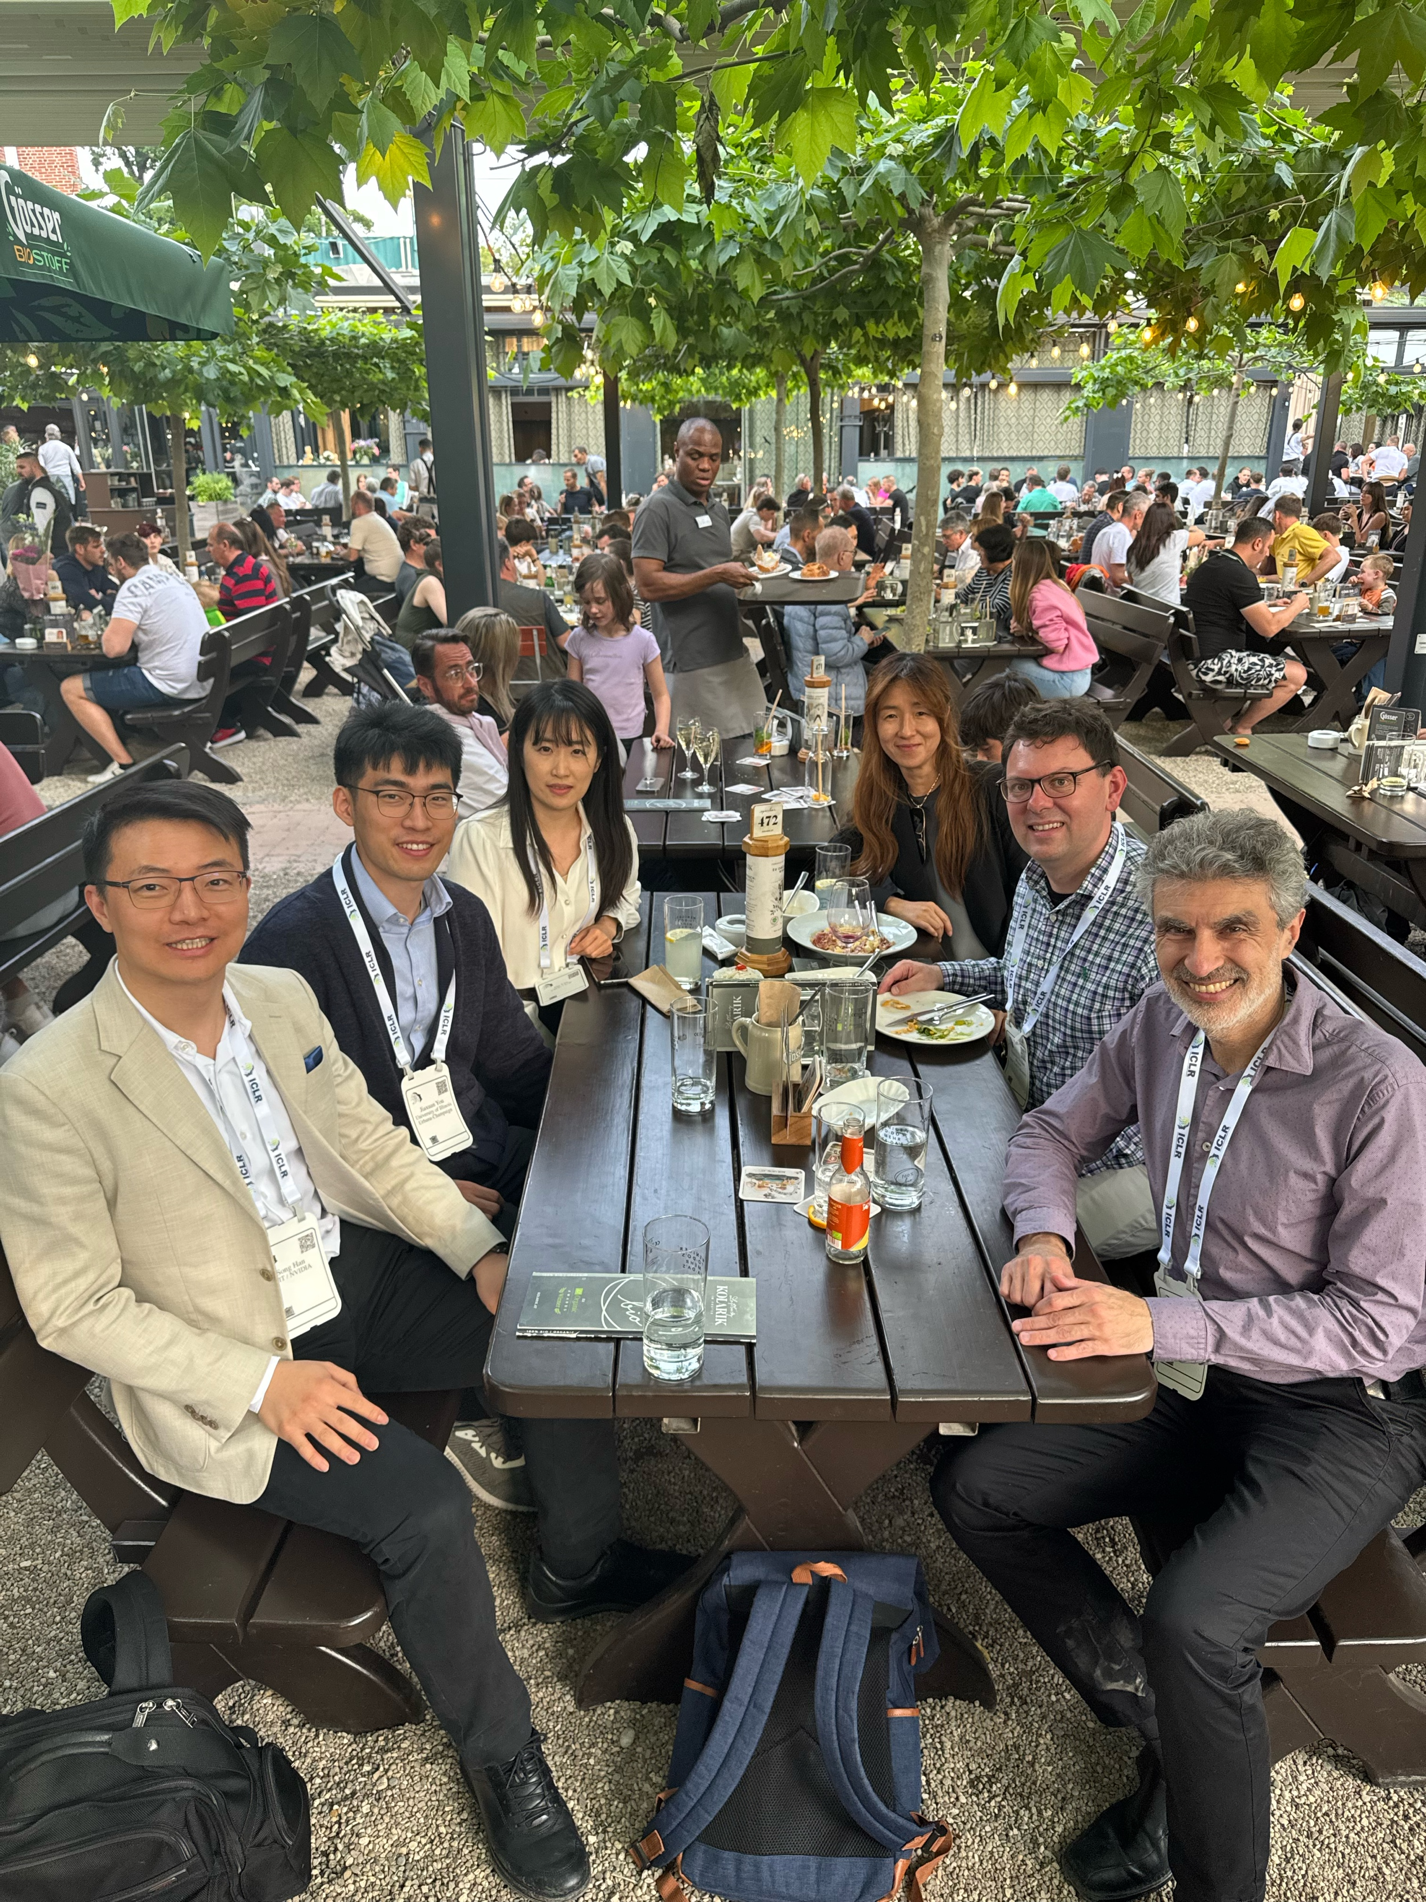
AGI Workshop @ ICLR 2024

Slide 25
Some Insights from AGI Workshop
Oriol Vinyals: Bring “G” back to AGI
General multimodal models with Ultra-long context
Yejin Choi: AGI is ambiguous; denial is futile
For generative models, hard could be easy, and easy could be hard
Generation vs understanding; commonsense tasks
Yoshua Bengio: safety concerns in AGI development
Align with human interests and mitigates risks of unintended consequences
AGI should not have self-preservation goal

Slide 26
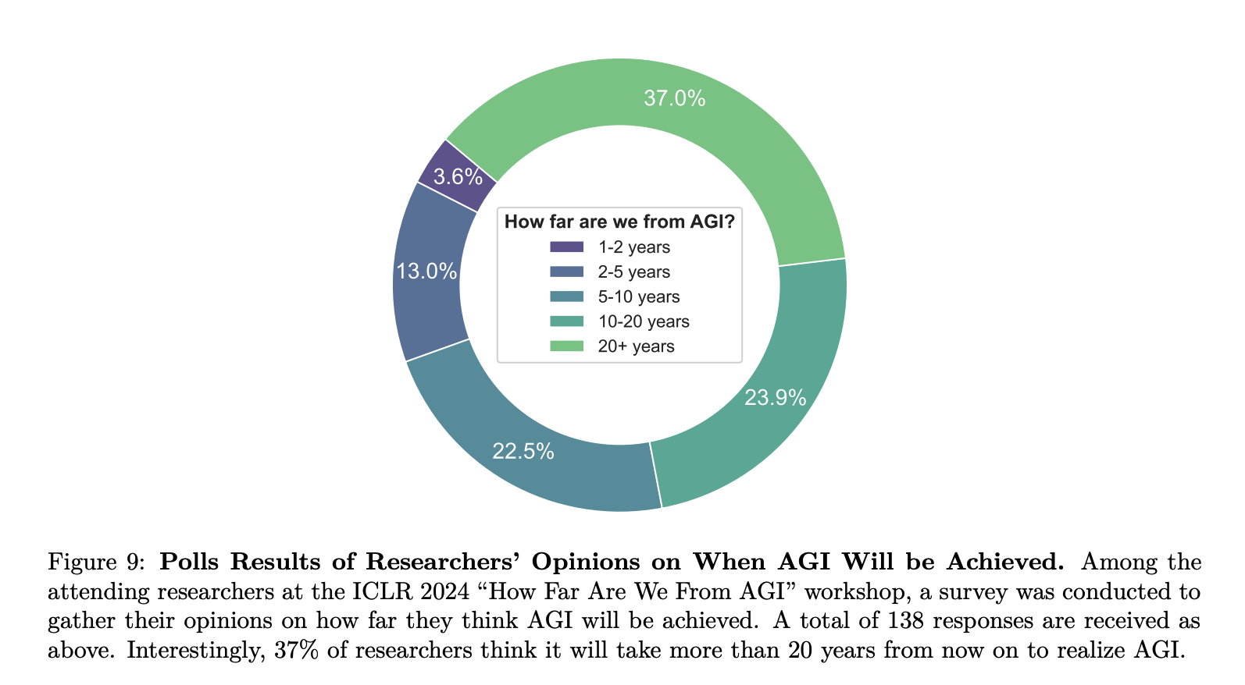
Poll from Workshop Audience

Slide 27
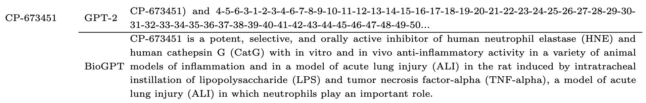
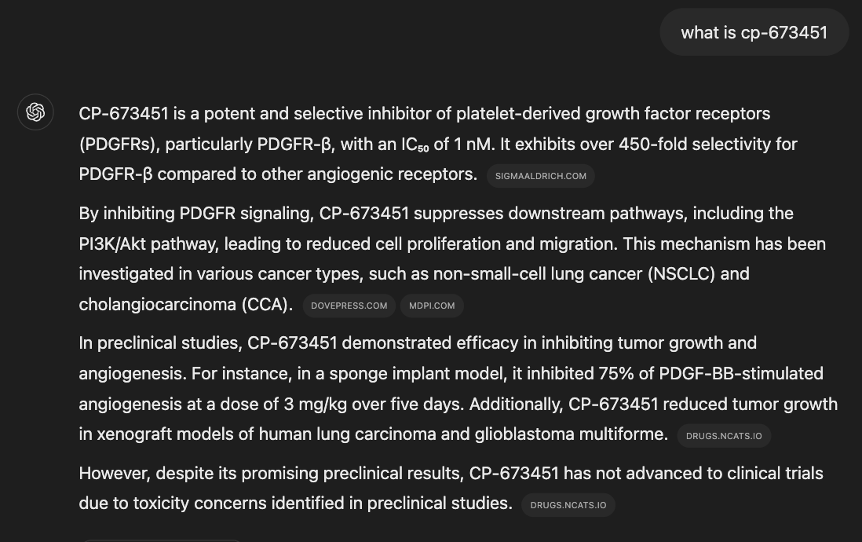
LLM Agent for Science
BioGPT: Generative Pre-trained Transformer for Biomedical Text Generation and Mining, Briefings in Bioinformatics 2022

Slide 28
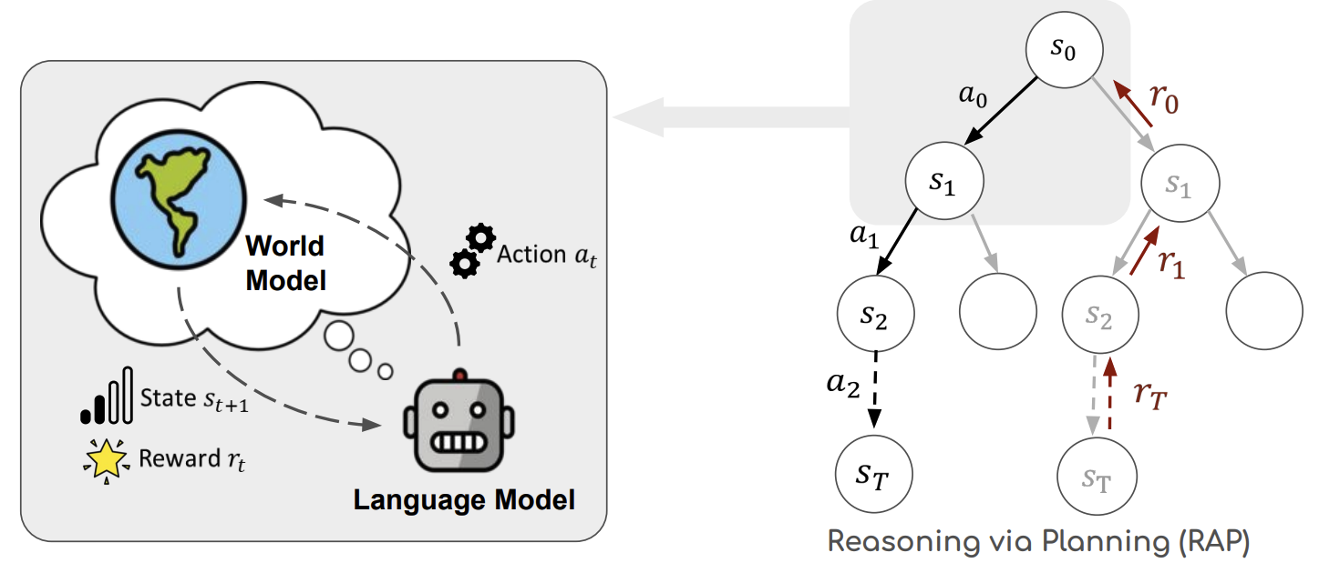
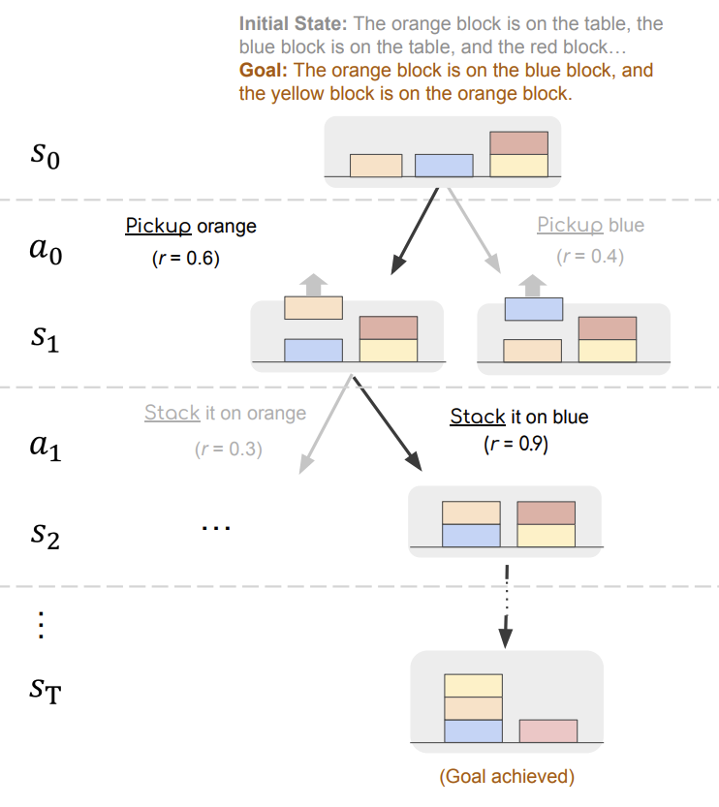
World Models for LLM Agents
Reasoning with Language Model is Planning with World Model, EMNLP 2023

Slide 29
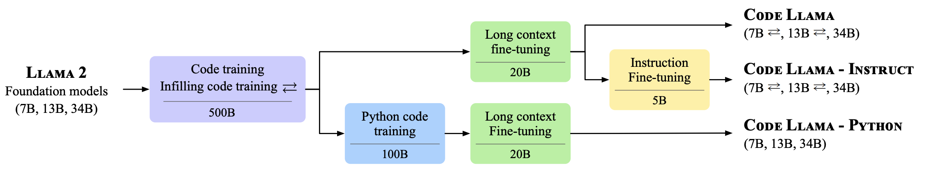
Code Foundation Models
Code Llama: Open Foundation Models for Code, 2023

Slide 30
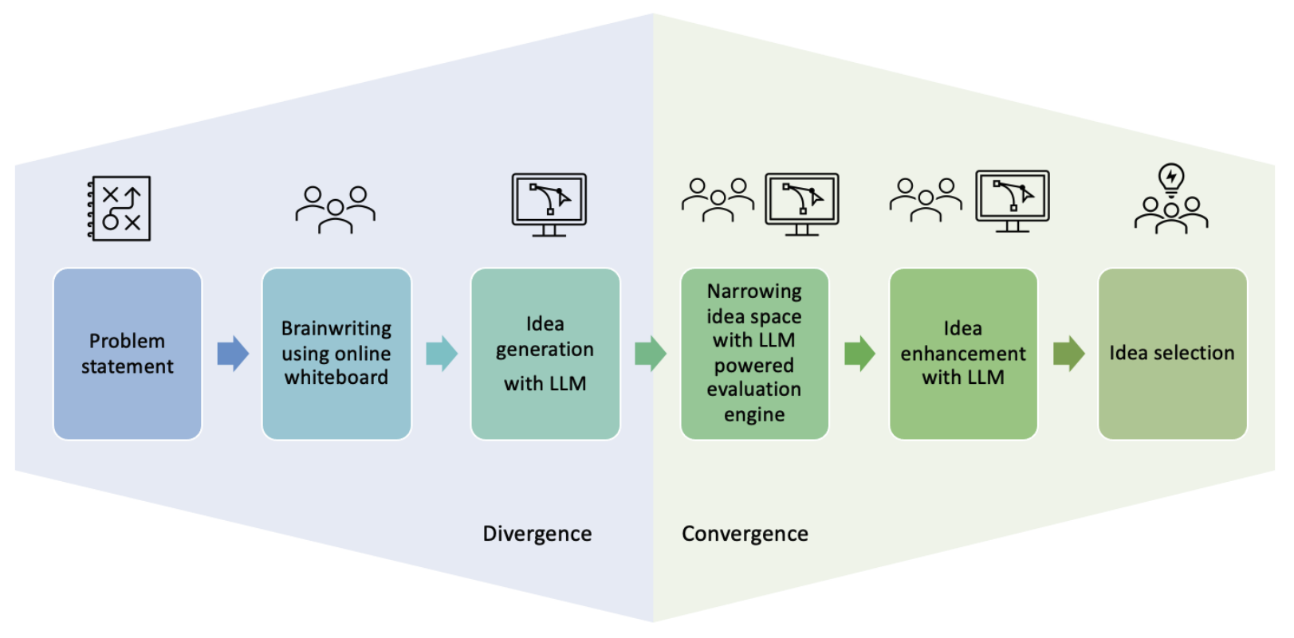
Human-LLM Collaboration
AI-Augmented Brainwriting: Investigating the use of LLMs in group ideation, 2024

Slide 31
Summary: A Framework for LLM Agent Research

Slide 32
Next: Student-led Seminars

Slide 33
In-class activity
In-class presentation/discussion
Takes 25% of the final grade
15% - 1 presentation as "pilot presenters"
10% - 1 panel & summary as " co-pilot reviewers"
Each group would be assigned each role once
Pilot Presenter
Co-pilot Reviewers
Rest of class-audience
Join the discussions
ALL activities will be done in groups except for your Pre-class activity!

Slide 34
In-class activity- Paper presentation
Presenter Group : Lead the discussion (details)
Slides should be submitted 1 day before the lecture
Aim for 40 min presentation w/o interruption, but there will be intermittent discussions
Go through the required papers in details, along with its strengths and weaknesses
Feel free to go beyond the suggested paper
ALL activities will be done in groups except for your Pre-class activity!

Slide 35
In-class activity- Panel discussion
"Reviewers" Group
Host a panel after the presentation together with Pilots
Reviewers challenge the presented paper, shared constructive feedback
Pilots and audience will debate with reviewers
Reviewers share summary of all the discussions within 2 days after class presentation
ALL activities will be done in groups except for your Pre-class activity!

Slide 36
Paper Summaries
1 summaries per-group, covering the review and discussions
Each summary should follow the template and address the following
What is the problem and why is it important?
What is the proposed solution, and what key insight guides their solution?
What is one (or more) drawback/limitation, and how will you improve it?
Key insights during the class discussion
Summary should include the gist of class discussion
Template here
ALL activities will be done in groups except for your Pre-class activity!

Slide 37
Summary of Your Role
Presenter Group
Reviewer Group
1.Share slides 24 hrs before class
2.Maximum 40-minute presentation
3.Respond to questions on Piazza
4.Share your final slides after class
Challenge the research paper
Host panel discussions
3. Share summary within 2 days after
class presentation
Everyone(Audience)
1.Read required papers
2.Submit one insightful question/idea per
required reading before each lecture

